Slide 1
Chatroom Application using Blockchain
Cryptography (BITS F463) - Project

Slide 2
Description
This project implements a chatroom using blockchain
A chatroom is similar to group chat. User needs to sign in to the website, and they are taken to the chatroom where every message they send is treated as a transaction
For every new user, public keys are created using their password (private key) & shared among other nodes.

Slide 3
Description
Each transaction is verified using Zero-Knowledge Proof on the “password” attribute of the answer
Mining a block places the verified transactions in a block and added to the blockchain, which is just a list of blocks
As part of mining, the miners do the proof of work, which takes significant amount of computation time
The blockchain is distributed across various nodes (machines). A new block added at one node is reflected at all the other nodes.

Slide 4
Important Functions
These functions are a significant part of our blockchain implementation
createBlock() in Blockchain.py
keygen() in keygen.py
verifyTransaction() in Blockchain.py
mine_block() in server.py
proof_of_work() in Blockchain.py
viewUser() in server.py

Slide 5
createBlock() in Blockchain.py
Each block is a dictionary in python storing:-
1. Index of the block
2. Timestamp
3. Nonce which is an integer value used for proof of work
4. The previous block hashed value using sha256 hashing algorithm
5. Data = The list of transactions where each transaction is a dictionary storing sender, message, and time at which the message is sent
The block is added to the list of nodes and the new list of nodes is added to the database

Slide 6
Zero Knowledge Proof Implementation
Using ZKP for discrete logs as given in https://people.eecs.berkeley.edu/~jfc/cs174/lecs/lec24/lec24.pdf
Generation of public key and private key
Whenever a new user enters the chatroom using “username” and “password” his respective public key is creating using keygen(password) function in keygen.py
Keygen function generates a large prime number ‘p,’ generates a random integer ‘A,’ calculates B = (A^x) mod(p) where ‘x’ is the first eight digits in hashed values of the password using ‘sha1’ hashing algorithm

Slide 7
Zero Knowledge Proof Implementation
Modular exponentiation is done using an efficient algorithm called the K-ary LR method
A large prime number is computed using nth_prime() function in keygen.py, which generates nth prime where n can be any value between 1000 and 10000. Also, caching the prime values in the local storage incase the same nth prime needs to be calculated again and not to waste any computation time
The public key of the user is (A, B, p) and is stored locally
‘X’ is the private key of the user, and it should be kept as secret
Computing x from (A, B, p) is computationally infeasible

Slide 8
Zero Knowledge Proof Implementation
Verifying the transaction
Now when the user sends a message, it is treated as a transaction and to verify the transaction we use the following process :
add_msg() function in server.py acts as prover and add_data() function in Blockchain.py acts as verifier
Prover chooses some random integer between 0 and p-2 (inclusive). Sends to the verifier value of h, which is (A^r)mod(p), which is calculated using the K-ary LR method, which is an efficient modular exponentiation algorithm

Slide 9
Zero Knowledge Proof Implementation
Verifier sends back a random bit ‘b’ (0 or 1)
Prover sends s = (r + b*x)mod(p-1) to the verifier
Verifier computes (A^s)mod(p) and verifier is add_data() function in blockchain.py which calls verifyTransaction() in blockchain.py which returns true if (A^s)mod(p) value is equal to (h*(B^b))mod(p) value
The add_msg() function in server.py performs this proof three times, and if all the three times the verifier sends true then the transaction is added to list of current transactions using add_data() function in blockchain.py

Slide 10
Zero Knowledge Proof Implementation
The verifier has verified that the prover knows the value of x without actually knowing the value of x
This process is known as Zero Knowledge Proof

Slide 11
Proof of work Implementation
ZKP verifies the transaction, and the transaction is added to the list of current transactions yet to be mined.
Before placing the current list of transactions in a new block and adding the block to the blockchain, proof of work problem has to be done.
The proof of work problem takes a significant amount of computation work, and the exact amount varies depending on the type of the problem and the computer solving the problem.

Slide 12
Proof of work Implementation
Why do we need proof of work?
It makes it hard to create a fake chain
To create a fake chain and adversary will need to work faster and also needs to catch up to the rest of the network to get the fake chain accepted, which is practically impossible, especially on some established blockchains like bitcoin.

Slide 13
Proof of work Implementation
There are various types of proof of work problems:-
Enumerating an integer that has some ‘k’ number of leading 0s when it is hashed using some hashing algorithm. That integer is known as the nonce.
Another one is to enumerate a nonce such that hash of the block number, data, previous hash, the nonce will have some ‘k’ number of leadings 0s

Slide 14
Proof of work Implementation
In our implementation as part of our proof of work, the function proof_of_work() in blockchain.py takes previous block nonce value as parameter and enumerates a new nonce such that hash of difference of squared new nonce and squared the previous nonce gives four leading 0s. Sha256 hashing algorithm is used.
mine_block() in server.py calls proof_of_work() to get a new nonce value and uses that nonce, current list of transactions, and previous block hash(hashed using sha256 algorithm) calls createBlock() in blockchain.py to create a new block and add it to the blockchain.

Slide 15
viewUser() in server.py
The function can be used to list all successful transactions against a user.
All successful transactions are stored in the blockchain, so this function iterates over all the blocks and returns all the transactions(messages sent) by that user.

Slide 16
Why do we need blockchain in chat based applications?
One of the most critical issues of present messengers is the lack of privacy. Whereas several apps use secure technologies and robust cryptography to create messages challenging to crack, it doesn't mean that users' private data are adequately secured.
This drawback could be resolved with blockchain. The immutable nature of blockchain ensures that the record during this info is correct and wasn't altered.
The data within the blockchain info is also distributed everywhere the globe, that means that the availability is much higher than in centralized systems where the core server can go offline

Slide 17
Why do we need blockchain in chat based applications?
Blockchain has speed limitations moreover. Even the quickest blockchain-based electronic messaging tool can invariably be slower than old-fashioned messengers, with every message delivery time consuming too many seconds.
While this technology has some restrictions, it conjointly provides a far higher degree of privacy than any popular centralized chat app can give.

Slide 18
Distributed System
The blockchain has a peer to peer connection among various nodes (machines).
Any new block added to one of the nodes is copied on all other nodes.
When a hacker attempts to modify the blockchain to his own wishes at one node, that blockchain is replaced with the correct version present at other nodes.
In the current implementation the longest chain is taken as the correct one.
This kind of decentralization makes it impossible to modify the blockchain and makes it more secure.
It is also resistant to failure at any of the nodes because of decentralization.

Slide 19
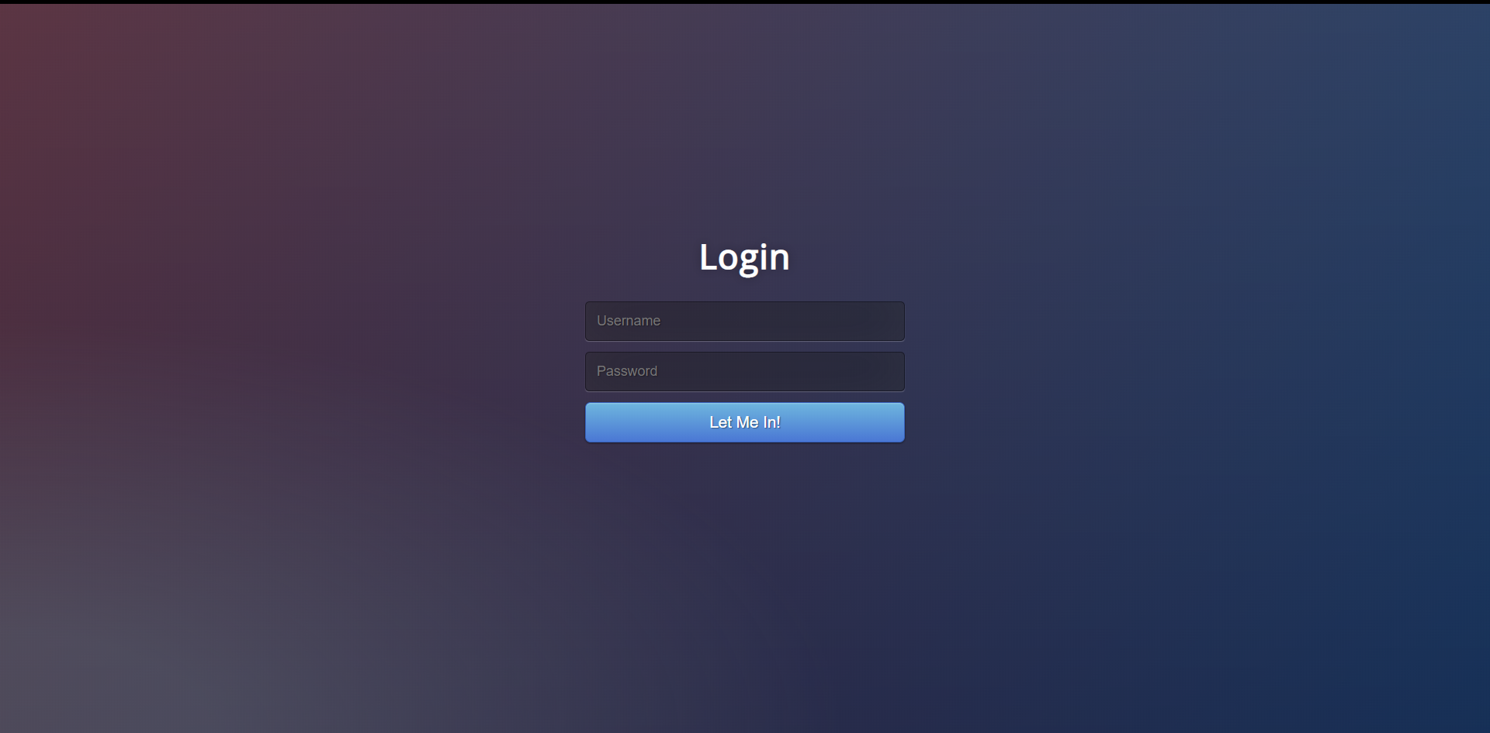
Interface
Login page :- New user/Existing user can sign in through this page
Notes:
When new user logins, corresponding public key is created and stored in publickeys.json file.
When existing user logins, his password (private key) is verified using ZKP.

Slide 20
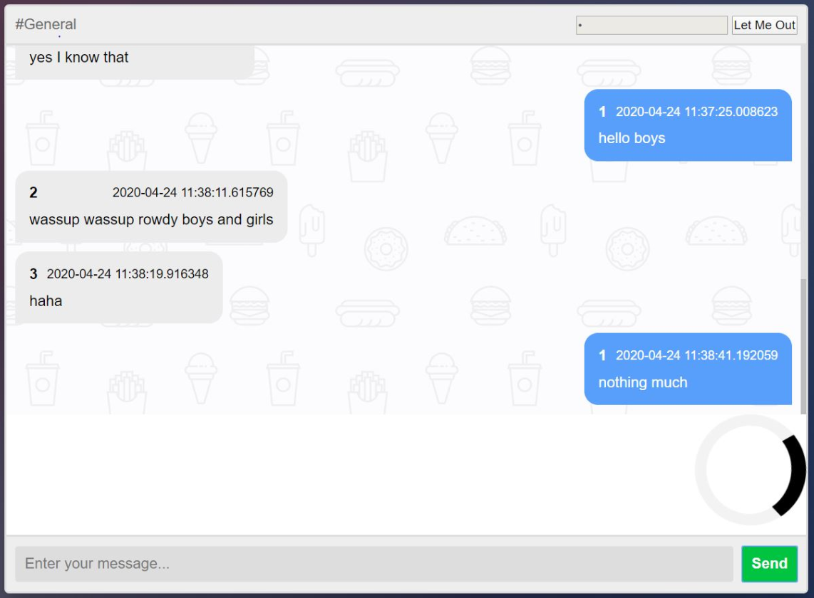
Chatroom:- Where users can chat
Notes:
Each time a user sends a message, that transaction is verified using ZKP.
The loading symbol in the UI = Verifying the transaction by the blockchain node.

Slide 21

Thank you
Team No 32 S Rohith 2017A7PS0034H Sai Charan 2017A7PS0110H C Mahesh Babu 2017A7PS0235H Hemanth 2017A7PS0231H Nimmagadda Bhargav 2017A7PS1574H
Birla Institute of Technology & Science, Pilani
Hyderabad Campus
Birla Institute of Technology & Science, Pilani
Hyderabad Campus

